Slide 1
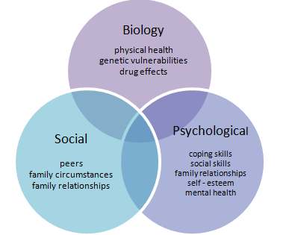
Feedback from adolescents and parents on the transition process to an adult Inflammatory Bowel Disease (IBD) service
Mary Hamzawi, Susan Brannick, Yvonne Hickey, Orna Brett Kilmurray, Fiona Jones, Prof Glen Doherty, Prof Hugh Mulcahy, Dr Juliette Sheridan, Dr G. Cullen
Background
Results
A nurse led service improvement project has implemented a structured Multidisciplinary team (MDT), biopsychosocial model of transition for adolescents.
International Guidelines recommend obtaining service user and carer/parent perspective on the transition process and identifying when additional emotional and psychological support is required. This had not been previously undertaken by the service.
Of the 13 responses from adolescents 85% felt ready to leave the children services at time of transfer compared to 71% of the parents.
Concerns about transfer was present for 86% of parents, but only 31% of the adolescents were concerned.
The majority, 92% of the adolescents felt they had a chance to talk about their concerns and would also be happy to individually contact the IBD nurses with questions.
Only 23% would like the IBD nurses to contact parents directly for information/medical updates.
A common theme in the open ended questions for both the adolescents and parents was the change in responsibility with the questions being directly asked to the adolescent and they are now the point of contact for the service.
The most common topics for more information provision were fatigue, stress, and diet and getting this from a website or individually were the preferred methods.
When attending clinic appointments adolescents always want to see a doctor but would like the opportunity to meet with the IBD nurse, dietitian and psychologist when required
85% of adolescents would consider using an online self booking system if available.
50% of adolescents reported that their IBD affected them emotionally and were concerned about their illness demonstrating the need for MDT support.
Method
13 adolescents, diagnosed with IBD in the paediatric tertiary referral hospital, and their parents/carer (7) who have been attending the adult service for 1 year were invited to complete a service designed, patient experience questionnaire. Findings would inform how well they have adapted to adult services.
Items from The Brief Illness Perception Questionnaire (B-IPQ) were used to measure how participants understand and are impacted by their IBD during the transition process. Negative illness perceptions are associated with anxiety, depression and poor quality of life.
Conclusion
Parents had greater concerns that their children in the transition process.
One year since transition, the adolescents felt they could express their concerns and would independently contact the service about these.
The service needs to provide more information about the topics such as fatigue, stress and diet and offer more support when adolescent is attending the infusion suite
The introduction to the IBD service of the patient information booklet, dedicated adolescent clinics, pre attendance MDT introduction meeting have helped create a positive experience for the adolescents and parents.
The MDT model of transition may help facilitate an individualised intervention pathway to increase information and address concerns, in order to improve outcomes for this group.
I didn’t get to say a proper goodbye to my team in the children’s hospital ☹
Its basically the same except doctors speak directly to you ☺
They(adult team) put more faith in you and remember important details

