Slide 1



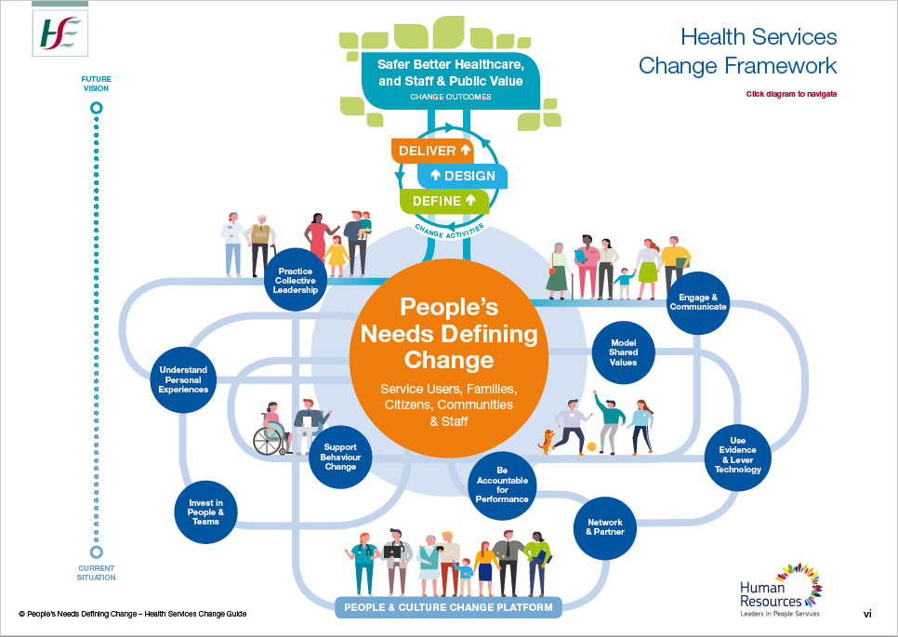
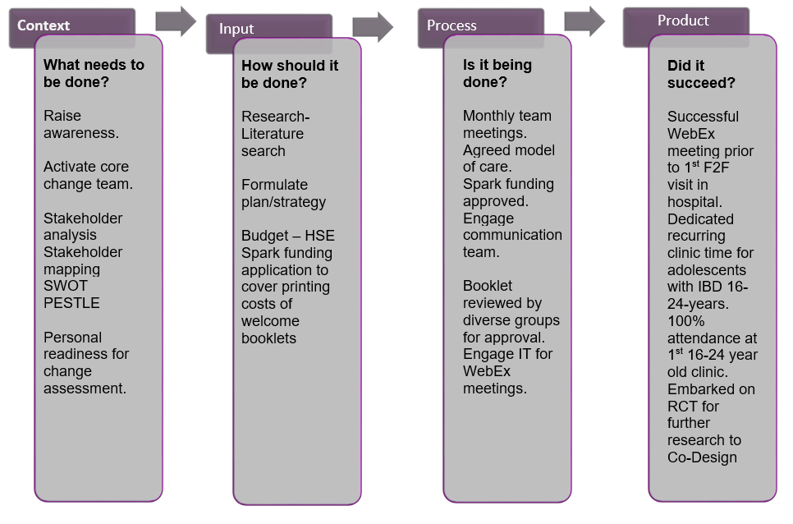

Development of a young persons clinic for 16-24-year-olds with Inflammatory Bowel Disease (IBD), using a Multidisciplinary Team (MDT) approach.
Mary Hamzawi, Susan Brannick, Yvonne Hickey, Fiona Jones, Prof Glen Doherty, Prof Hugh Mulcahy, Dr Juliette Sheridan, Dr G. Cullen
Introduction
Change Process
Evaluation of Results
Inflammatory Bowel Disease (IBD) is a chronic disease of the gastrointestinal tract.. 25% of patients attending adult hospitals have been diagnosed as children.
In Ireland transition to adult services occurs at 16years of age.
Transition is an essential milestone for adolescents with IBD as critical functioning skills necessary for self-management are not fully developed and adolescents often find it difficult to engage with health care professionals.
To date an ideal transition model has not been defined
Peoples Needs Defining Change Health Services Change Guide (2018)
Define
Design
Design Welcome Booklet
Deliver
Review Force Field analysis
Develop vision in line with organisational culture
Raise awareness of need
Proposed care pathway for adolescents.
Determine time allocated for recurring adolescent clinic
HSE Spark funding secured to print booklets
Activate core change team
Virtual Meet and Greet due to Covid restrictions
Use of CIPP evaluation model to evaluate the development of an OPD clinic for 16-24 year olds with MDT approach.
AIM and OBJECTIVES
Discussion
This study aims to develop a young person clinic for 16-24-year-olds with IBD, using an MDT approach. Providing the right care, in the right place, at the right time, where the patient is a priority, is the end goal (Slaintecare, 2019)
Objectives
1.Obtain authorisation to progress this change project, bringing together appropriate stakeholders to co-design a structured clinic for 16-24-year-olds with Inflammatory Bowel Disease (IBD) by 30th Nov 2020
2. Obtain approval for and design a 'welcome booklet' to support service users by March 2021
3. Identify a suitable clinic time that could be dedicated to 16-24year olds repeatedly by Feb 2021
In Ireland the IBD transition process is ad hoc with no formal guidelines on how to conduct transition clinics. The literature recommends structured transition clinics and education of health care professionals in adolescent health. Providing information to adolescents and their family prior to their first clinic can reduce anxiety. This was shown with the satisfaction of adolescents and family to virtual WebEx meet and Greet and the welcome booklet received prior to their first visit.
The successful implementation of this project was facilitated by the HSE, Peoples Needs Defining Change (2018) model . It provided the essential toolkit to ensure leadership, teamwork, the importance of stakeholders while keeping the patient central to all decisions made. Leadership is required to change people's mindsets and patterns of behaviour to support change, This change is in keeping within the organisation's values, beliefs, and assumptions
Other information
Application for funding to print the welcome booklets was successful through HSE ‘Spark’ funding. This is a national innovation programme to encourage healthcare innovation from front line workers.
One of the outcomes from this project has been the decision to progress to a pilot RCT run over 2 years on the transition cohort. The RCT will guide development of young person clinics. Ethical approval has been granted.

